Slide 1


Rapid application development (RAD)

Slide 2
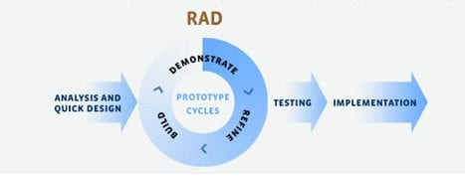
5 pasos o fases en RAD

Slide 3
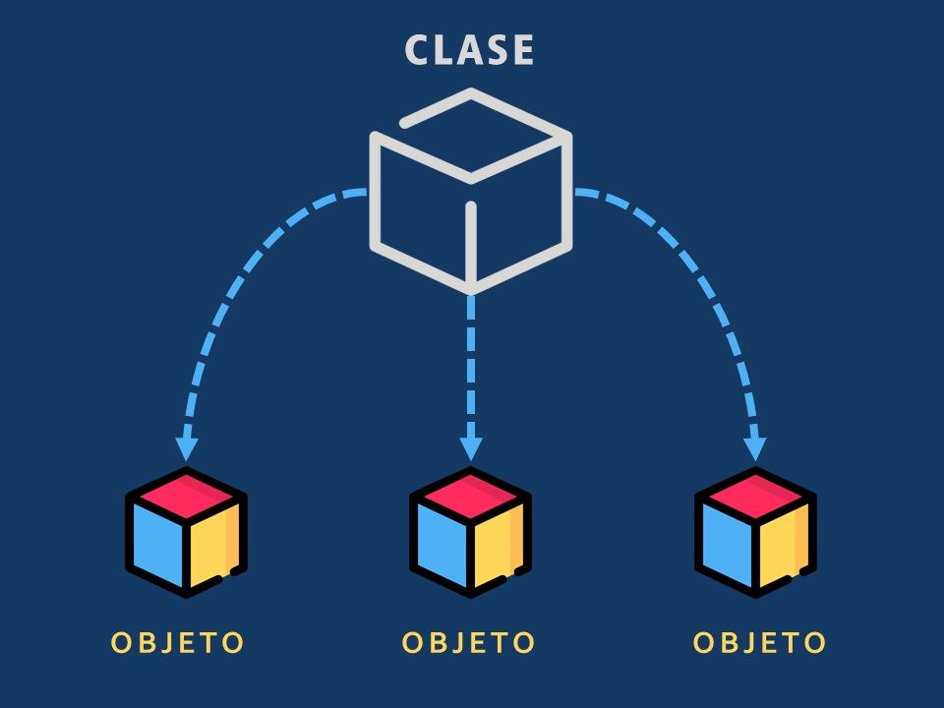
Programacion Orientada a OBjetos

Slide 4

Caracteristicas

